Slide 1

Visión por Computador
Domingo Mery
Departmento de Ciencia de la Computación
Escuela de Ingeniería
Universidad Católica de Chile
Multiple View Applications in X-ray Testing

Slide 2
X-ray testing: Baggage screening

Slide 3
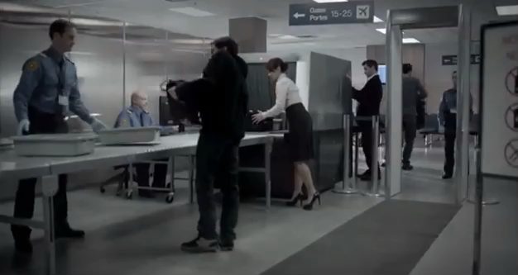
X-ray testing: Baggage screening

Slide 4
X-ray testing: Baggage screening

Slide 5
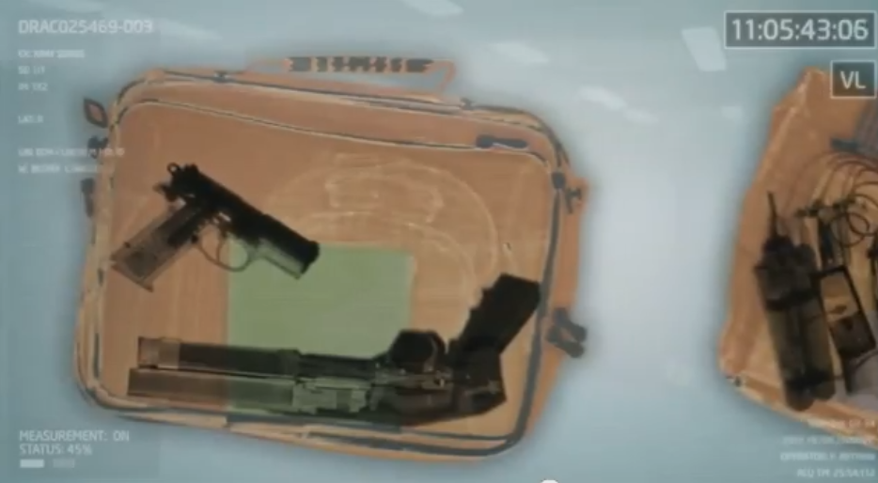
X-ray testing: Baggage screening

Slide 6
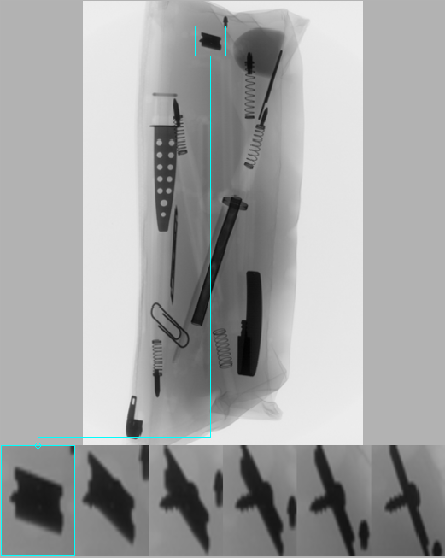
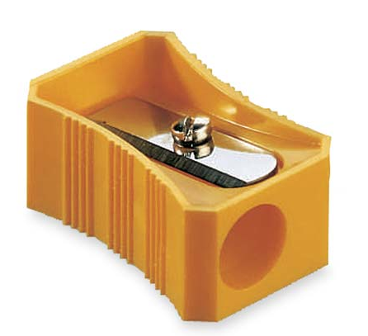
Our goal:
Detection of objects of interest
Views of each object in all frames

Slide 7
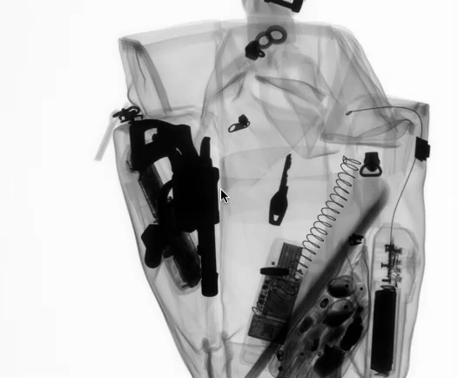
X-ray testing: Baggage screening
Key ideas of our methods:
Computer vision
Multiple views analysis
Active vision

Slide 8
X-ray Testing: Multiple view analysis

Slide 9
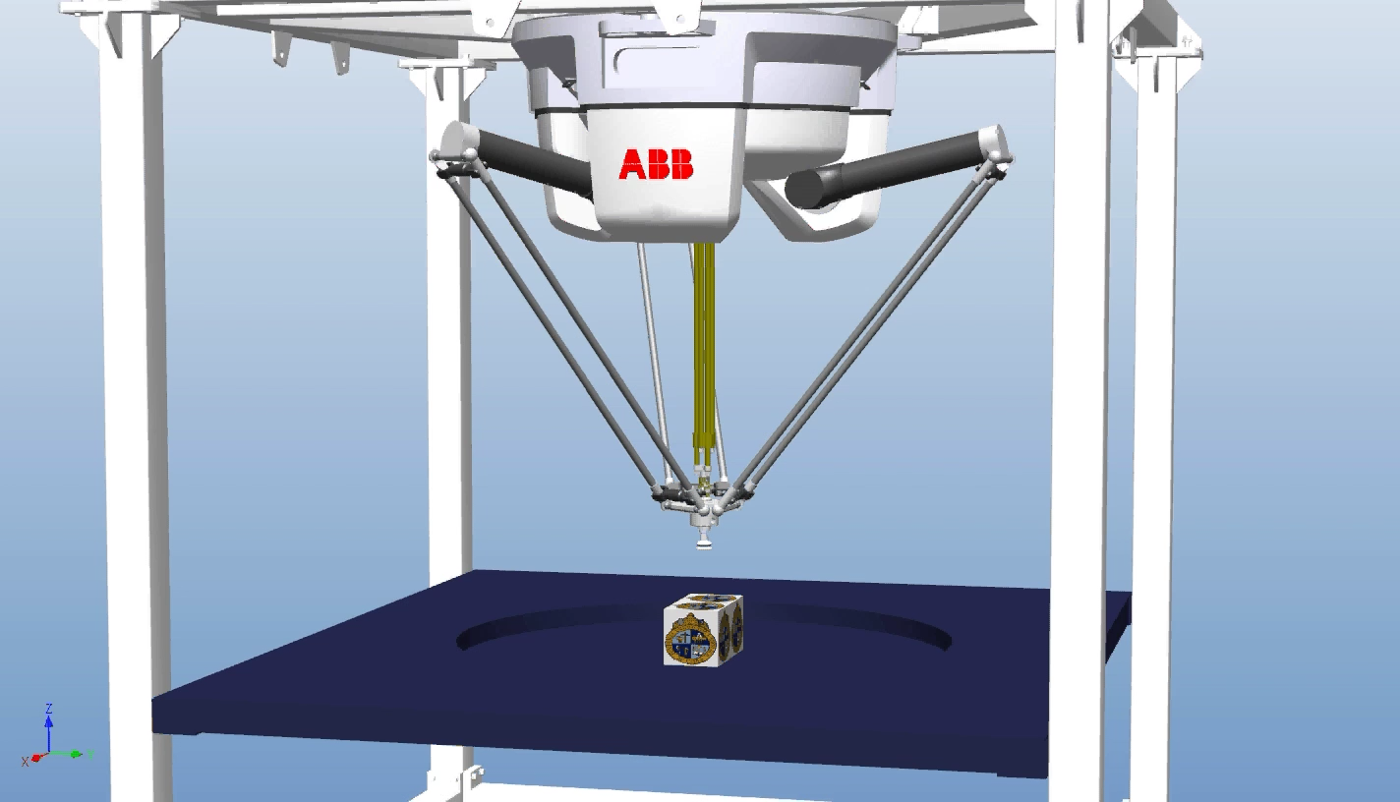
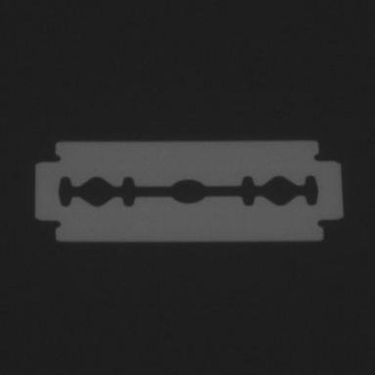
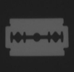
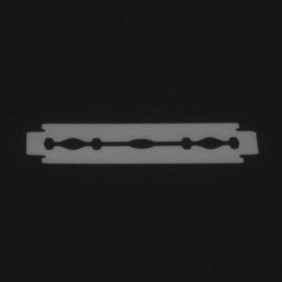
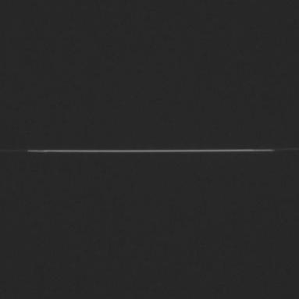
X-ray Testing: Multiple view analysis

Slide 10
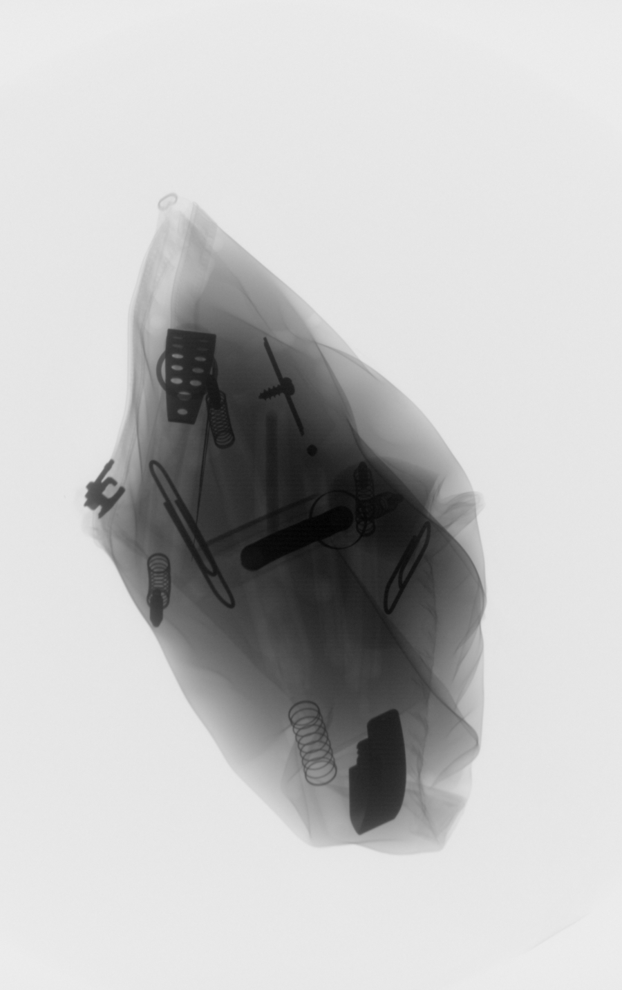

Slide 11
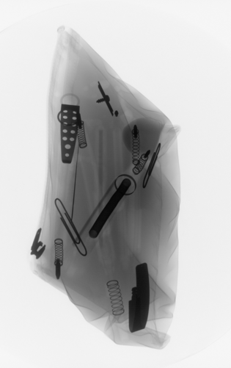

Slide 12
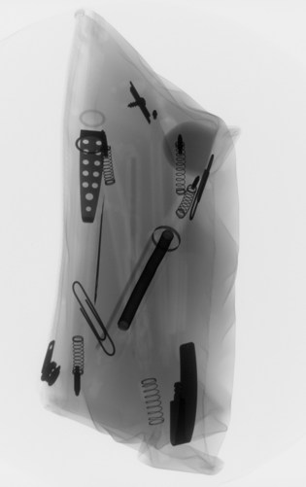

Slide 13
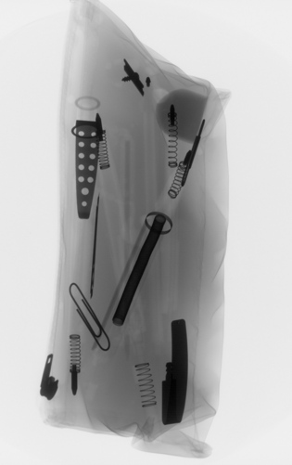

Slide 14
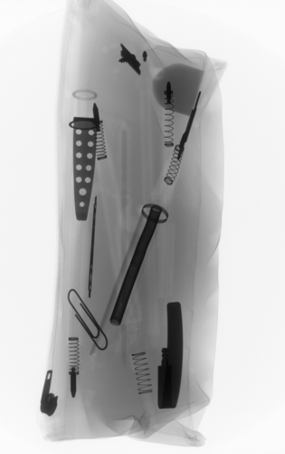

Slide 15
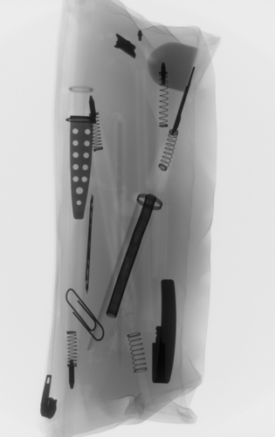

Slide 16
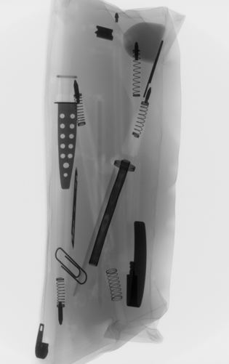

Slide 18
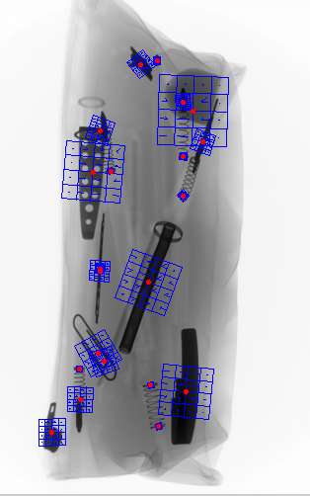
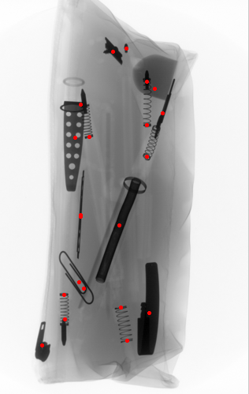
SIFT description for each segmented region

Slide 19
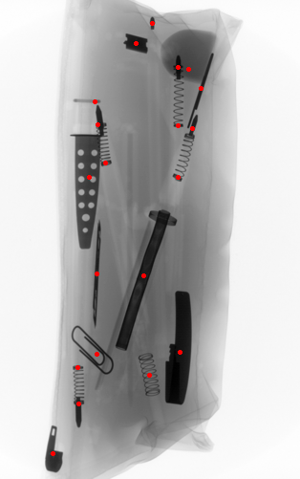
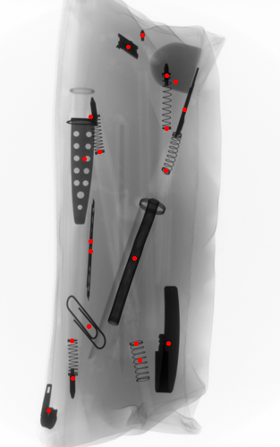
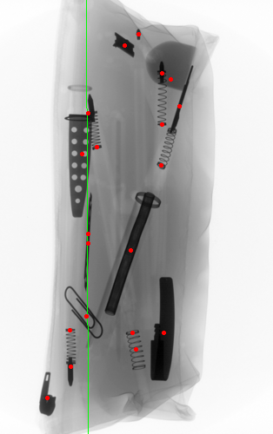
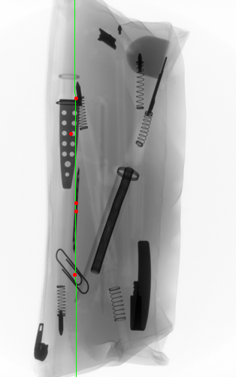
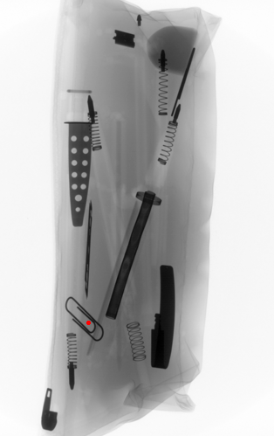
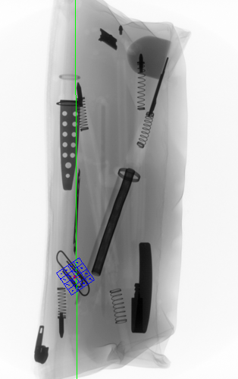
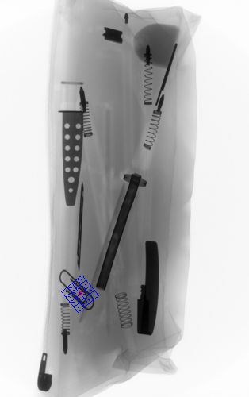
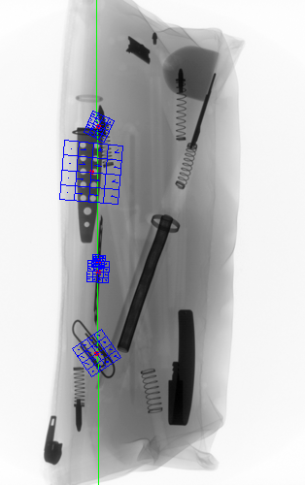
Tracking in 2 views
Epipolar line
Example
Image 1 Image 2

Slide 20
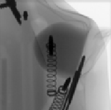
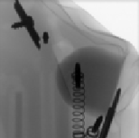
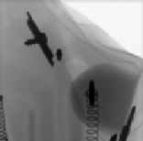
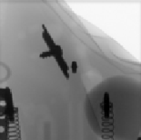
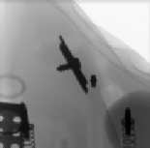
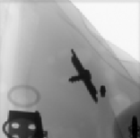
Tracking algorithm

Slide 21
Tracking algorithm

Slide 22
Tracking algorithm

Slide 23
Tracking algorithm
?

Slide 24
Tracking algorithm

Slide 25
Tracking algorithm
It is not required that the object parts have to be segmented in all views because the missing views can be reconstructed.
It is allowed to have false segmentations because they are filtered out.

Slide 26
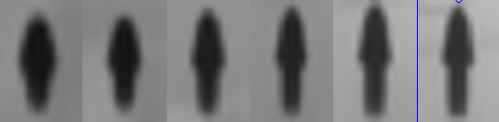
Tracking algorithm
Analysis: Feature extraction and Classification
Detection

Slide 27
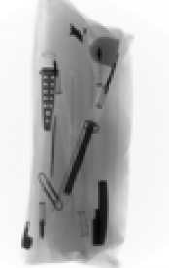
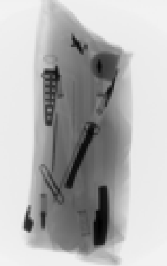

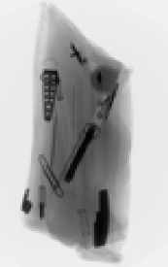

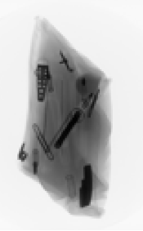

Slide 28
P₃
P₄
P₅
P₂
P₆
P₁

Slide 29
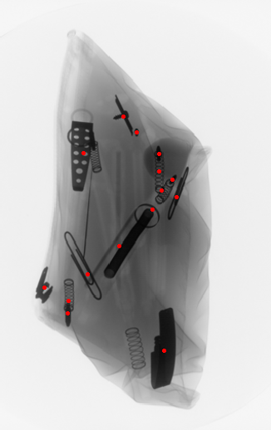
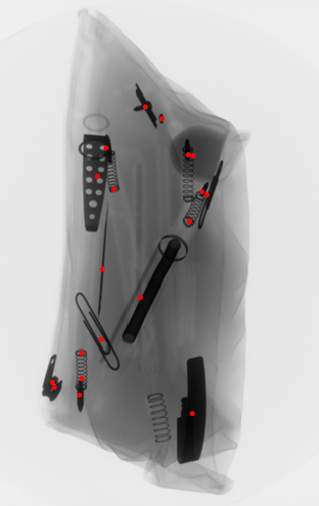
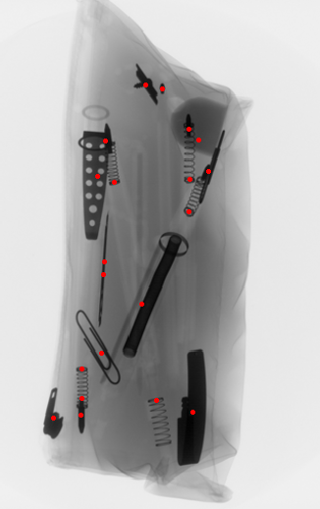
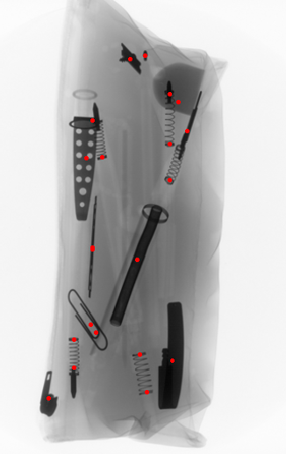
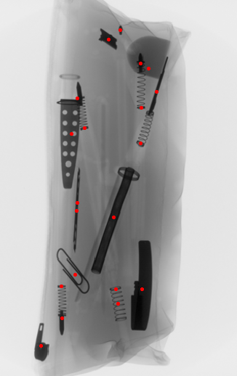
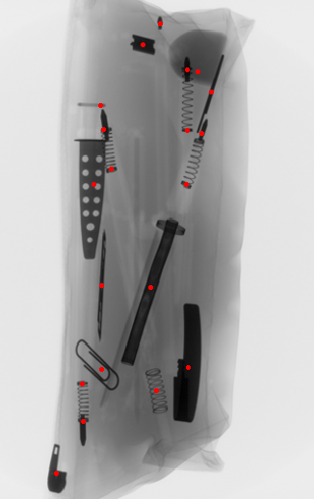
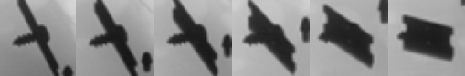
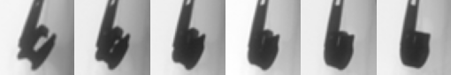
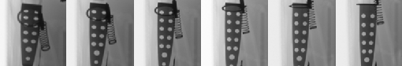
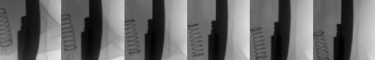


X-ray Testing: Multiple view analysis

Slide 30
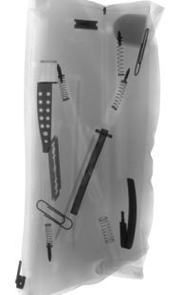
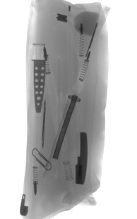


Multiple view analysis
.
.
.
.
.
.
.
.
.
.
.
.
.
.
.
.
.
.
.
.
.
.
.
.
.
.
.
.
.
.
.
.
.
.
.
.
.
.
.
.
.
.
.
.
.
.
.
.
.
.
.
.
.
.
.
.
.
.
.
.
.
.

Slide 31
c'
Multiple view analysis
Majority vote
h
h
h
h
h
h
h
h
. . .
. . .
. . .
. . .
.
.
.
.
.
.
.
.
.
.
.
.
.
.
.
.
.
.
.
.
.
.
.
.
.
.
.
.
.
.
.
.
.
.
.
.
.
.
.
.
.
.
Notes:
A cluster can be misclassified if the part that we are trying to recognize is occluded by a part of another class. In this case, there will be keypoints in the cluster assigned to both classes; however, we expect that the majority of keypoints will be assigned to the true class if there are a small number of keypoints misclassified.

Slide 32

Multiple view analysis: Experimental Results
[ BLADE ]

Slide 33

Multiple view analysis: Experimental Results
[ CLIPS ]

Slide 34

Multiple view analysis: Experimental Results
[ SPRINGS ]

Slide 35





Multiple view analysis: Experimental Results
Recognition with some degree of occlusion
[ SPRING ] [ SPRINGS ] [ CLIP ] [ CLIP ] [ BLADE ]

Slide 36



Active Vision: Principle
I₂
I₁
?

Slide 37
Active Vision: Algorithm
Number of Images = 0
Position = Random Position
Repeat until Number of Images < N
Move inspection object to Position
Acquisition of a new X-ray image
Number of Images = Number Images + 1
Single view detection:
[DETECTION] End
[NOTHING] Position = Position + Θ
Go to step 2
[COULD BE] Pose estimation
Estimation of Better Position
Position = Better Position
Go to step 2

Slide 38


Active Vision: Pose description

Slide 39





Active Vision: Single view detection and pose estimation
Image acquisition and
keypoints detection
Clusters of keypoints
Merged clusters
Pose Estimation

Slide 40

Active Vision: Robotic system

Slide 41









Active Vision: Experimental results
1
2
3
Acquisition
Detection Stage
Pose
ND
Pose
48
Pose
29
Pose Estimation

Slide 42

Active Vision: Experimental results

Slide 43

Active Vision: Experimental results
Other regular objects (like shuriken) and other descriptors (like Implicit Shape Model).

Slide 44
More Examples

Slide 45

Detection of a razor blade

Slide 46

Detection of a razor blade

Slide 47

Detection of pins

Slide 48

Detection of guns (mono detection)

Slide 49

Detection of guns (multiple view)

Slide 50

Detection of guns (multiple view)

Slide 51
What can we do with a sequence?

Slide 52













W₃
W₄
W₂
W₁
W₅
B₃
W₆
B₂
B₄
B₁
B₅
B₆
C₆
C₁
C₅
C₂
C₄
C₃

Slide 53










Slide 54

W₃
W₄
W₂
W₁
W₅
B₃
W₆
B₂
B₄
B₁
B₅
B₆
C₆
C₁
C₅
C₂
C₄
C₃

Slide 55














a) Tracked object
3
4
2
5
1
6
b) Segmented object
c) Computed tomography
d) 3D reconstruction

Slide 56


Slide 57


Slide 58





